Slide 1
Machine Learning Based Filtered Drag Force Model Yundi Jiang, Jari Kolehmainen, Yile Gu Yannis Kevrekidis , Ali Ozel & Sankaran Sundaresan Princeton University, NJ 2018 NETL Workshop on Multiphase Flow Science
Funded by ExxonMobil

Slide 2
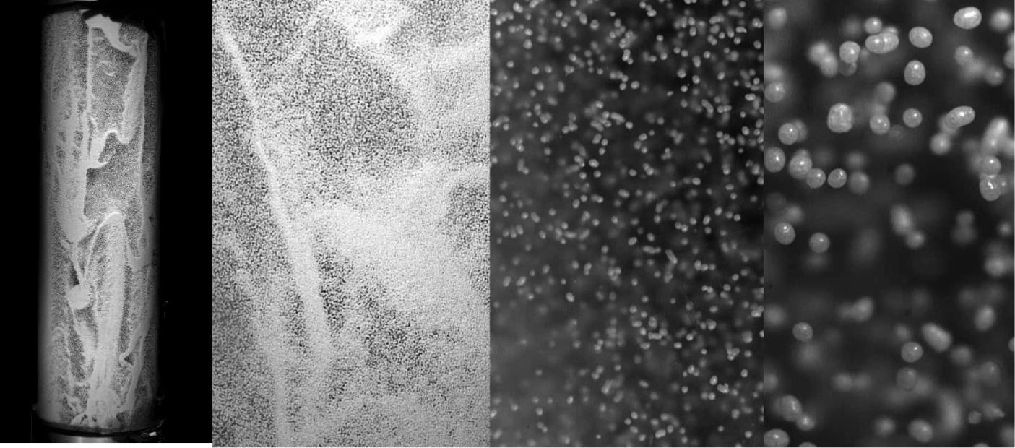
Background
Gas–particle flows in fluidized beds
Inherently unstable with multiscale structures
Weight of particle is principally balanced by the drag force
Accurate estimation of the drag force is essential for reliable prediction of flow behavior
Frank Schaffer, NETL
Notes:
Fluidized beds are widely used in industrial applications. Gas particle flows in these devices are inherently unstable, which leads to inhomogeneous structures over a wide range of length and time scales. Large flow structures can be in the vessel scale, and small structures can be in the scale of several particle diameters. For the design and scale-up of fluidized bed, we need to understand these multiscale structures. . In gas particle flows, the weight of particles is principally balanced by the drag force, so an accurate estimation of the drag force is especially essential for the reliable prediction of the flow behavior and bed hydrodynamics.

Slide 3
Multi-scale structures in gas-particle Flow
Fine-grid simulations¹
Euler-Euler Approach
Continuum averaged equations of motion for the fluid and solid phases
Coarse-grid simulations
Filtered Euler-Euler Approach
1. Igci, Y., Andrews, A. T., Sundaresan, S., Pannala, S. and O'Brien, T. (2008), Filtered two-fluid models for fluidized gas-particle suspensions. AIChE J., 54: 1431–1448
Notes:
For fine-grid simulations, we can use Euler-Euler approach. This method solves continuum averaged equations of motion for both solid and gas phases.
For large-scale systems, resolving all the detailed structures are impractical due to computing limitations, and therefore filtered Euler-Euler approach is introduced to study such systems on coarse grid without having to resolve all the fine-scale flow structures

Slide 4
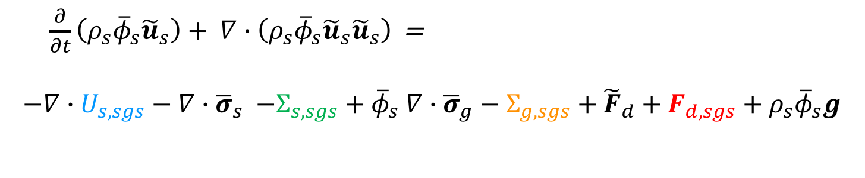
Multi-scale structures in gas-particle Flow
Particle phase momentum balance in Two-fluid model
$$\frac{∂}{∂t}\left(ρ_{s}φ_{s}u_{s}\right)+ ∇∙\left(ρ_{s}φ_{s}u_{s}u_{s}\right)=−∇∙σ_{s} −φ_{s}∇∙σ_{g}+F_{d}+ρ_{s}φ_{s}g$$
Upon filtering
Particle phase momentum balance in Filtered Two-fluid model
$\frac{∂}{∂t}\left(ρ_{s}{\overline{φ}}_{s}{\tilde{u}}_{s}\right)+ ∇∙\left(ρ_{s}{\overline{φ}}_{s}{\tilde{u}}_{s}{\tilde{u}}_{s}\right)$ =
$$−∇∙U_{s,sgs}−∇∙{\overline{σ}}_{s} {−Σ_{s,sgs}+\overline{φ}}_{s}∇∙{\overline{σ}}_{g}−Σ_{g,sgs}+{\tilde{F}}_{d}+F_{d,sgs}+ρ_{s}{\overline{φ}}_{s}g$$
Notes:
Consider the Eulerian solid phase momentum equation. After filtering, we get the filtered momentum equation for solid phase. When we filter the model, in addition to taking averages of the variables in the micro-scale equation, we have to include these sub-grid scale terms,

Slide 5
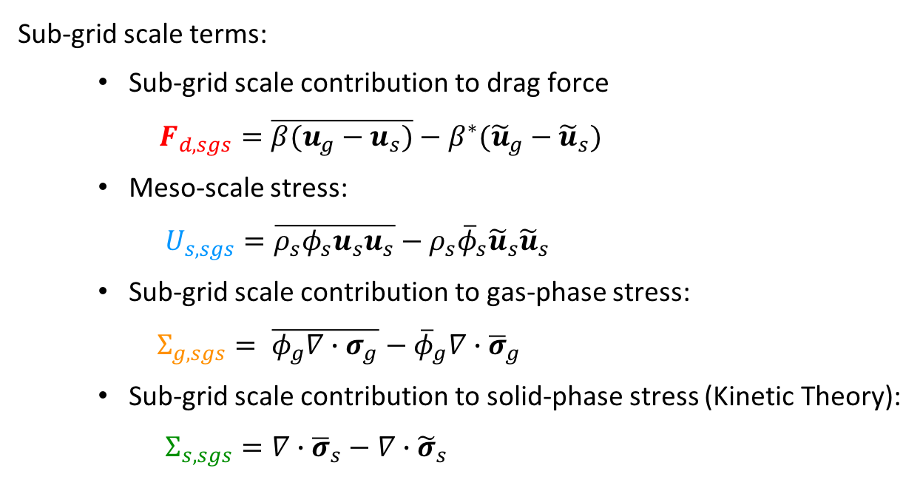
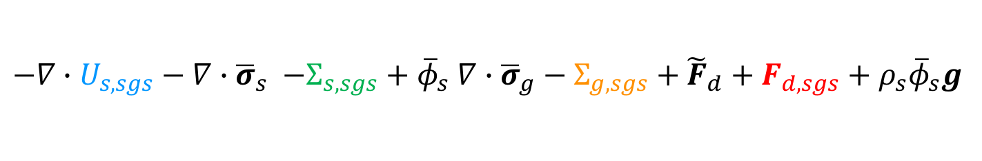
Multi-scale structures in gas-particle Flow
$$−∇∙U_{s,sgs}−∇∙{\overline{σ}}_{s} {−Σ_{s,sgs}+\overline{φ}}_{s}∇∙{\overline{σ}}_{g}−Σ_{g,sgs}+{\tilde{F}}_{d}+F_{d,sgs}+ρ_{s}{\overline{φ}}_{s}g$$
Sub-grid scale terms:
Sub-grid scale contribution to drag force
$F_{d,sgs}=\overline{β(u_{g}−u_{s})}−β^{∗}({\tilde{u}}_{g}−{\tilde{u}}_{s})$
Meso-scale stress:
$U_{s,sgs}=\overline{ρ_{s}φ_{s}u_{s}u_{s}}−ρ_{s}{\overline{φ}}_{s}{\tilde{u}}_{s}{\tilde{u}}_{s}$
Sub-grid scale contribution to gas-phase stress:
$Σ_{g,sgs}= \overline{φ_{g}∇∙σ_{g}}−{\overline{φ}}_{g}∇∙{\overline{σ}}_{g}$
Sub-grid scale contribution to solid-phase stress (Kinetic Theory):
$Σ_{s,sgs}=∇∙{\overline{σ}}_{s}−∇∙{\tilde{σ}}_{s}$
most significant
- unresolved structures in filtered models
- need to be modeled to account for meso-scale inhomogeneities
5. Parmentier, J.-F., Simonin, O. and Delsart, O., (2012), AIChE J., 58: 1084–1098
6. Ozel, A.,Fede, P., Simonin, O., (2013) Int. J Multiph. Flow, 55:43-63 0301 -93222.
7. Ozel, A. et al., (2017) Physics of Fluid (2017) 29: 103308.
Notes:
Here we define the sub-grid scale terms. We have subgrid-scale contribution to the drag force, meso-scale stress which originates from the convection term on the left-hand-side. The sub-grid scale contribution to gas-phase stress, and sub-grid scale contribution to the solid-phase stress which is closed by kinetic theory. These terms come from the unresolved structures in filtered models, and they need to be modeled to account for the meso-scale inhomogeneities. According to the budget analysis in prior studies and also confirmed in our analysis, the sub-grid scale contribution to the drag force is the most significant among all these terms.

Slide 6
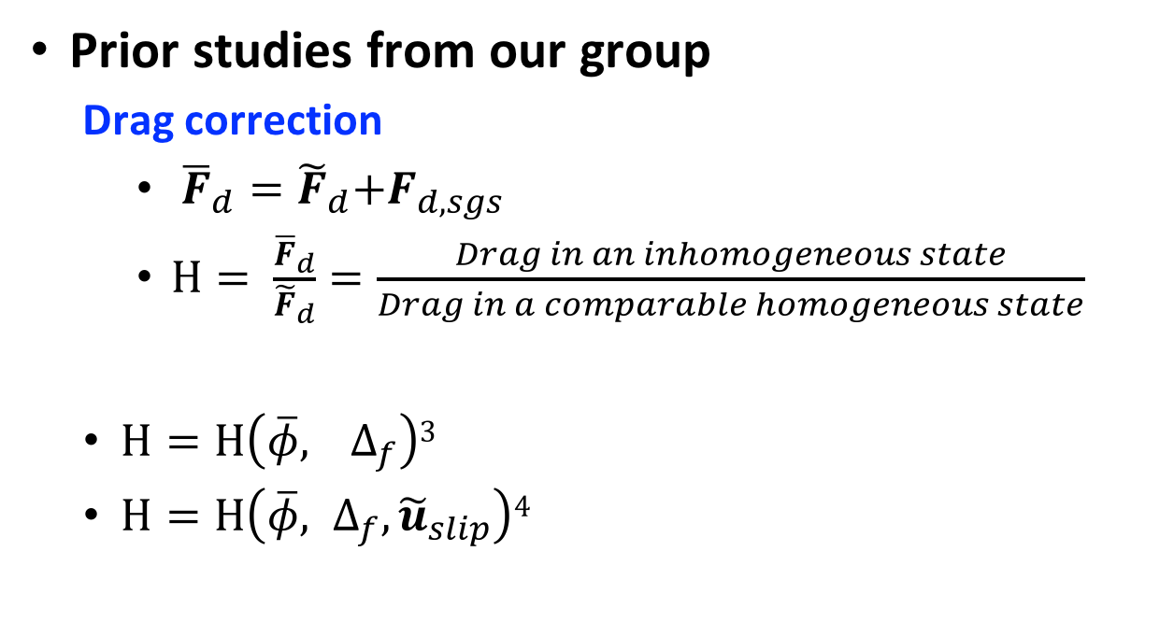
Modeling filtered drag force
Prior studies from our group
Drag correction
${ {\overline{F}}_{d}=\tilde{F}}_{d}+F_{d,sgs}$
$H= \frac{{\overline{F}}_{d}}{{\tilde{F}}_{d}}=\frac{Drag in an inhomogeneous state}{Drag in a comparable homogeneous state}$
$H=H\left(\overline{φ}, { ∆}_{f}\right)3$
$H=H\left(\overline{φ}, Δ_{f},{\tilde{u}}_{slip}\right)4$
3. Igci, Y., Sundaresan, S., (2011) Ind. Eng. Chem. Res. 50 (23): 13190-13201
4. Milioli,C., Milioli, F.E., Holloway, W., Kapil, A., Sundaresan, S., (2013). AIChE J. 59..
Notes:
Previously, our group has been trying to develop constitutive models for account for the sub-grid drag term using drag correction. Previous modeling attempt included modeling the drag correction term as defined here using particle volume fraction and filter size, and then in terms of particle volume fraction, filter size, and slip velocity

Slide 7

Modeling filtered drag force
Toulouse group approach^{5,6} and also our current approach⁷
$${ F}_{d,sgs}≈ β^{∗}{\tilde{v}}_{d}$$
$β^{∗}$: Microscopic drag coefficient evaluated with filtered variables
${\tilde{v}}_{d}$ : Drift velocity
${\tilde{v}}_{d}=\frac{\overline{φu_{g}}−\overline{φ}{\tilde{u}}_{g}}{\overline{φ}}$
Takes into account inhomogeneities inside filtering volume
Difference between filtered gas velocity and gas velocity seen by the particles
Not available in coarse simulations - need to be modeled
5. Parmentier, J.-F., Simonin, O. and Delsart, O., (2012), AIChE J., 58: 1084–1098
6. Ozel, A.,Fede, P., Simonin, O., (2013) Int. J Multiph. Flow, 55:43-63 0301 -93222.
7. Ozel, A. et al., (2017) Physics of Fluid (2017) 29: 103308.
Notes:
In the present study, we use the approach originally proposed by Toulous group to model the sub-grid contribution to drag force with drift velocity as presented here. Here beta star is the microscopic drag coefficient evaluated using filtered variables, and drift velocity is defined here as the difference between filtered gas velocity and the gas velocity seen by the particles. The drift velocity takes into account the inhomogeneities inside the filtering volume. However, we are faced with one challenge: this drift velocity is not available in coarse simulations and it needs to be modeled.

Slide 8
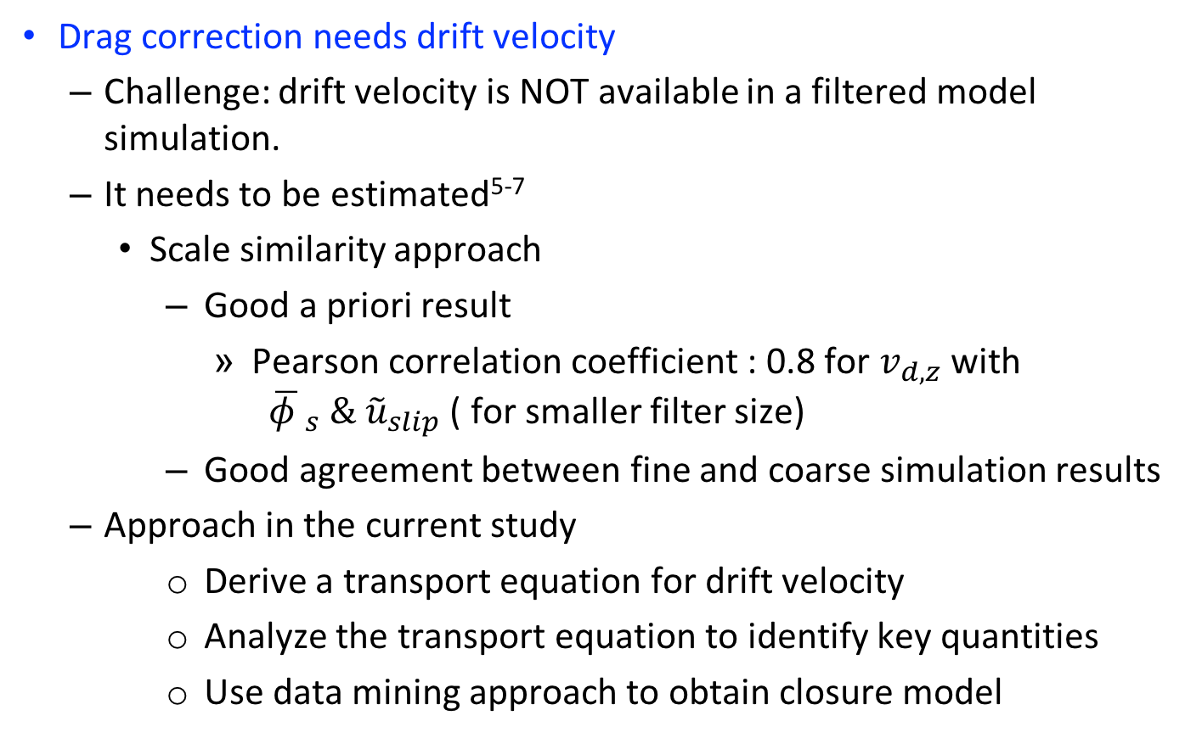
Drift velocity for drag force correction
Drag correction needs drift velocity
Challenge: drift velocity is NOT available in a filtered model simulation.
It needs to be estimated⁵⁻⁷
Scale similarity approach
Good a priori result
Pearson correlation coefficient : 0.8 for $v_{d,z}$ with ${ \overline{φ }}_{s} \& {\tilde{u}}_{slip}$ ( for smaller filter size)
Good agreement between fine and coarse simulation results
Approach in the current study
Derive a transport equation for drift velocity
Analyze the transport equation to identify key quantities
Use data mining approach to obtain closure model
7. Ozel, A. et al., (2017) Physics of Fluid (2017) 29: 103308.
Notes:
So to address this challenge, our group applied scale similarity approach, to estimate the drift velocity. This approach produced good a priori result with a Pearson coefficient of 0.8 for flow-direction drift velocity using variables solid volume fraction and slip velocity. Also in posteriori test, decent agreement between fine- and coarse- grid simulation results were found for 2-D simulation. However, the decrease in correlation coefficient with increasing filter size suggests that the model to predict the drift velocity should include additional markers. So in the current approach, we aim to explore this marker that we are potentially missing. We start by deriving a transport equation, and then analyze it to identify the key variables for predicting it, and then we apply data mining approach, in this study we use neural network to obtain a closure model for it.

Slide 9
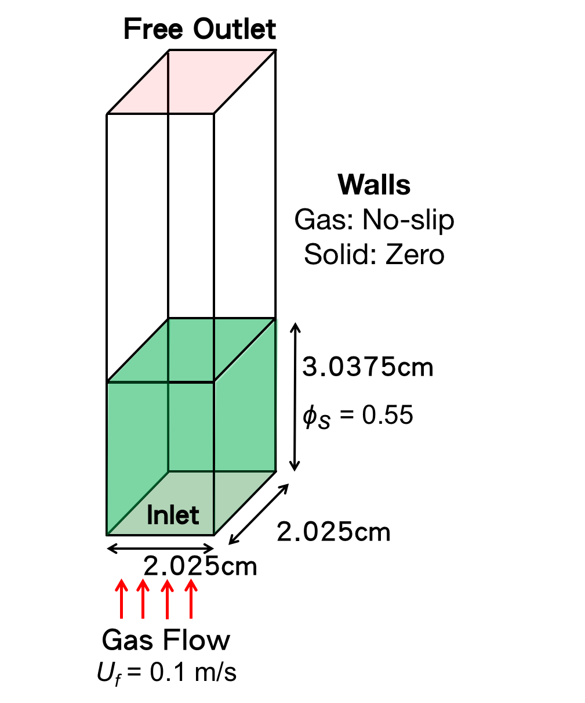
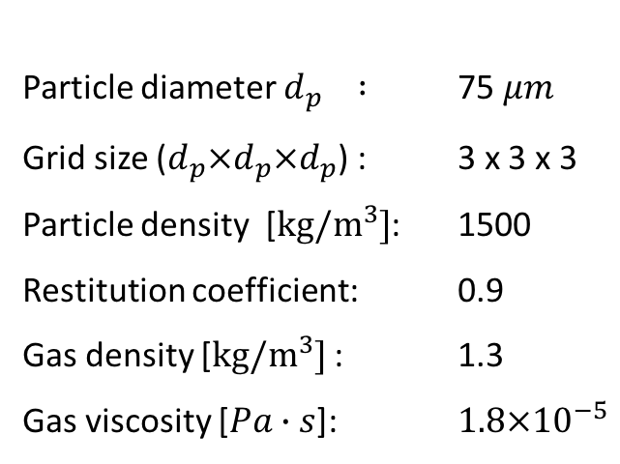
Fine-grid Euler-Euler simulation
Flow Configuration
& Simulation Parameters
Particle diameter $d_{p} :$ 75 $μm$
Grid size ($d_{p}×d_{p}×d_{p}$) : 3 x 3 x 3
Particle density [$kg/m^{3}]$: 1500
Restitution coefficient: 0.9
Gas density [$kg/m^{3}]$ : 1.3
Gas viscosity [$Pa∙s$]: $1.8×{10}^{−5}$
Notes:
To gather data for model development, we ran 3-D simulation of a dense fluidized bed as shown here. We have a bed with square cross section with approximately 2cm by 2 cm, and the initially the particles are uniformly distributed with a solid volume fraction 0.55 and 3 cm high. We have a free outlet on the top, and gas inlet with 10cm /s from the bottom. The wall boundary conditions are no-slip for gas and zero for particles. We use geldart A type particle with 75 um diameter, and grid size of 3dp.

Slide 10
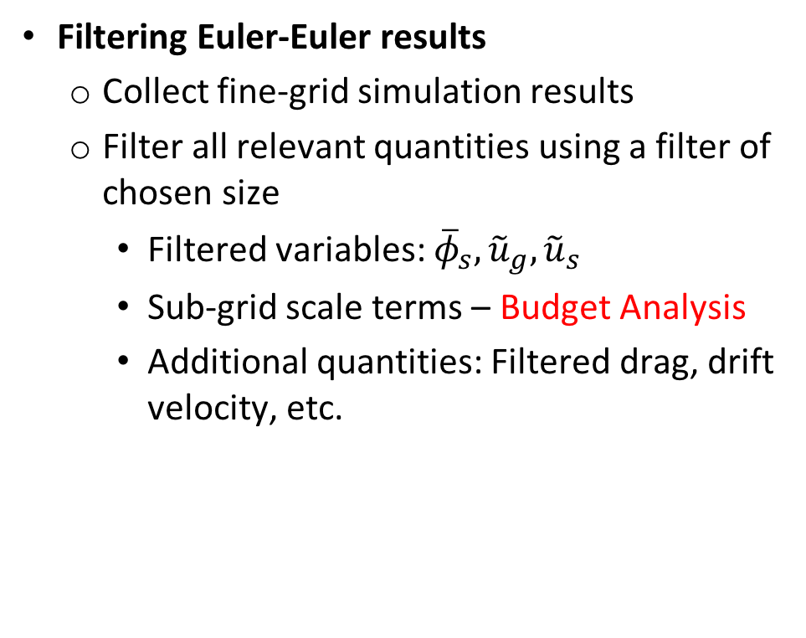

Fine-grid Euler-Euler simulation
Filtering Euler-Euler results
Collect fine-grid simulation results
Filter all relevant quantities using a filter of chosen size
Filtered variables: ${\overline{φ}}_{s}, {\tilde{u}}_{g},{\tilde{u}}_{s}$
Sub-grid scale terms – Budget Analysis
Additional quantities: Filtered drag, drift velocity, etc.
$$φ_{s}$$
Notes:
we collect fine-grid simulation data, and we filter all the relevant quantities using filters of various sizes. This way, we obtained the filtered variables, the sub-grid scale terms, as well as other quantities like filtered drag force, and drift velocity.

Slide 11
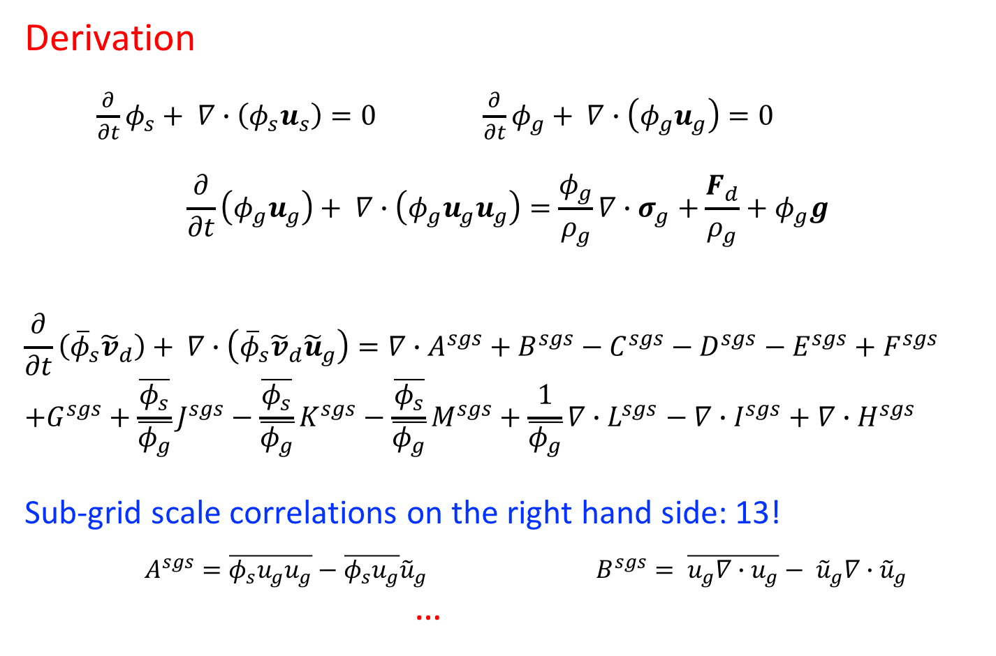
Transport equation for drift velocity
Derivation
$\frac{∂}{∂t}φ_{s}+ ∇∙\left(φ_{s}u_{s}\right)=0 \frac{∂}{∂t}φ_{g}+ ∇∙\left(φ_{g}u_{g}\right)=0$
$$\frac{∂}{∂t}\left(φ_{g}u_{g}\right)+ ∇∙\left(φ_{g}u_{g}u_{g}\right)=\frac{φ_{g}}{ρ_{g}}∇∙σ_{g}+\frac{F_{d}}{ρ_{g}}+φ_{g}g$$
$$\frac{∂}{∂t}\left({\overline{φ}}_{s}{\tilde{v}}_{d}\right)+ ∇∙\left({\overline{φ}}_{s}{\tilde{v}}_{d}{\tilde{u}}_{g}\right)=∇∙A^{sgs}+B^{sgs}−C^{sgs}−D^{sgs}−E^{sgs}+F^{sgs}$$
$$+G^{sgs}+\frac{\overline{φ_{s}}}{\overline{φ_{g}}}J^{sgs}−\frac{\overline{φ_{s}}}{\overline{φ_{g}}}K^{sgs}−\frac{\overline{φ_{s}}}{\overline{φ_{g}}}M^{sgs}+\frac{1}{\overline{φ_{g}}}∇∙L^{sgs}−∇∙I^{sgs}+∇∙H^{sgs}$$
Sub-grid scale correlations on the right hand side: 13!
$A^{sgs}=\overline{φ_{s}u_{g}u_{g}}−\overline{φ_{s}u_{g}}{\tilde{u}}_{g}$ $B^{sgs}= \overline{u_{g}∇∙u_{g}}− {\tilde{u}}_{g}∇∙{\tilde{u}}_{g}$
…
Notes:
With all the fine-grid data ready, we move onto identifying key quantities to estimate drift velocity. Starting from micro-scale continuity equations for gas and solid phase, and the gas phase momentum equation, we derived the transport equation for the drift velocity. The transport equation turns out to have thirteen sub-grid scale correlations on the right hand side.

Slide 12

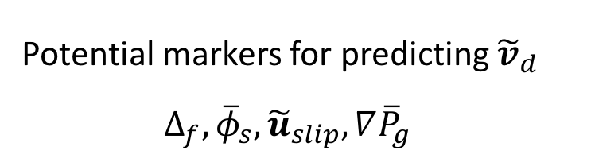
Transport equation for drift velocity
Budget Analysis: Assess relative magnitudes of the terms
$$\frac{∂}{∂t}\left({\overline{φ}}_{s}{\tilde{v}}_{d}\right)+ ∇∙\left({\overline{φ}}_{s}{\tilde{v}}_{d}{\tilde{u}}_{g}\right)=\frac{1}{{\overline{φ}}_{g}}𝒳^{sgs}+𝒴^{sgs}$$
$𝒳^{sgs}=\overline{\frac{φ_{g}}{ρ_{g}}∇P}−\overline{\frac{φ_{g}}{ρ_{g}}}\overline{∇P}$
$𝒴^{sgs}=\overline{\frac{φ_{p}}{φ_{g}}\frac{F_{d}}{ρ_{g}}}−\frac{{\overline{φ}}_{p}}{{\overline{φ}}_{g}}\frac{{\overline{F}}_{d}}{ρ_{g}}$
Potential markers for predicting ${\tilde{v}}_{d}$
$$∆_{f}, {\overline{φ}}_{s}, {\tilde{u}}_{slip}, ∇{\overline{P}}_{g}$$
Notes:
To asses the relative magnitudes of these thirteen different terms, we performed budget analysis. After budget analysis, we identified two terms that are significantly larger in magnitude than the rest as defined here. One of them is related to sub-grid scale pressure gradient fluctuations, and the other is related to sub-grid scale drag force fluctuations. We can see that these two terms are similar in magnitude and almost balance each other, so setting left hand to zero and modeling drift velocity with an algebraic equation should be sufficient. Also deducing from the expression of X and Y which are the most important terms, we can see that the potential markers for predicting drift velocity is filter size, solid volume fraction, slip velocity, and gas-phase pressure gradient.

Slide 13
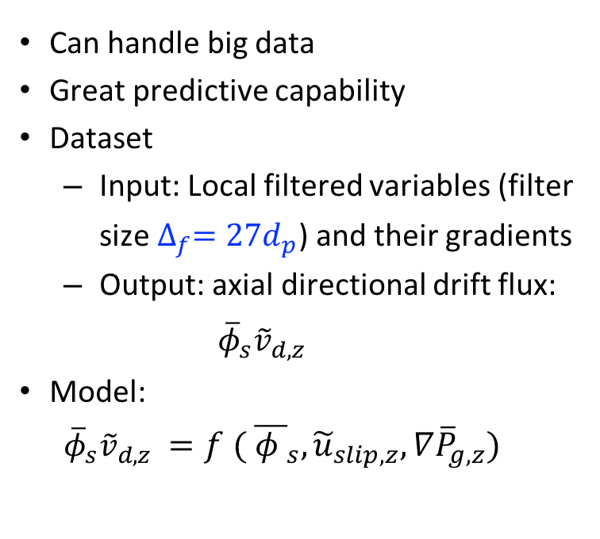
Constitutive models with machine learning
Neural Network model for predicting drift velocity
Input Layer
$${ \overline{φ }}_{s}, {\tilde{u}}_{slip,z}, ∇{\overline{P}}_{g,z}$$
Input Layer
〖 (𝜙 ) ̅〗_𝑠, 𝑢 ̃_(𝑠𝑙𝑖𝑝,𝑧), 𝛻𝑃 ̅_(𝑔,𝑧)
Hidden Layer 1
128 Neurons with ReLU activation
Output Layer
$${\overline{φ}}_{s}{\tilde{v}}_{d,z}$$
Output Layer
𝜙 ̅_𝑠 𝑣 ̃_(𝑑,𝑧)
Hidden Layer 2
64 Neurons with ReLU activation
Hidden Layer 3
16 Neurons with ReLU activation
Can handle big data
Great predictive capability
Dataset
Input: Local filtered variables (filter size $∆_{f}=27d_{p}$) and their gradients
Output: axial directional drift flux:
$${\overline{φ}}_{s}{\tilde{v}}_{d,z}$$
Model:
${\overline{φ}}_{s}{\tilde{v}}_{d,z} {=f ( \overline{φ }}_{s}, {\tilde{u}}_{slip,z}, ∇{\overline{P}}_{g,z})$
Notes:
In the present study, we focus on modeling and implement isotropic drag correction to guarantee Galilean invariance and also because the reliability of our lateral direction data remains questionable. To do this, we calculate the correction based on flow direction variables, and apply the same correction to all the directions. Accordingly, we focus on predicting the z-direction drift velocity in the present study. For modeling approach, we use neural network because it provides some nice benefits such as that it can handle large dataset, and its great predictive capability. So we feed in the filtered variables we found potential from the budget analysis, filtered solid volume fraction, slip velocity, and pressure gradient, and use three hidden layers with 128, 64, and 16 neurons and ReLu activation function. The neural network model will then predict the axial direction drift flux, which is defined as the product of solid volume fraction and drift velocity.

Slide 14
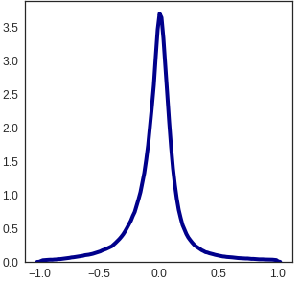
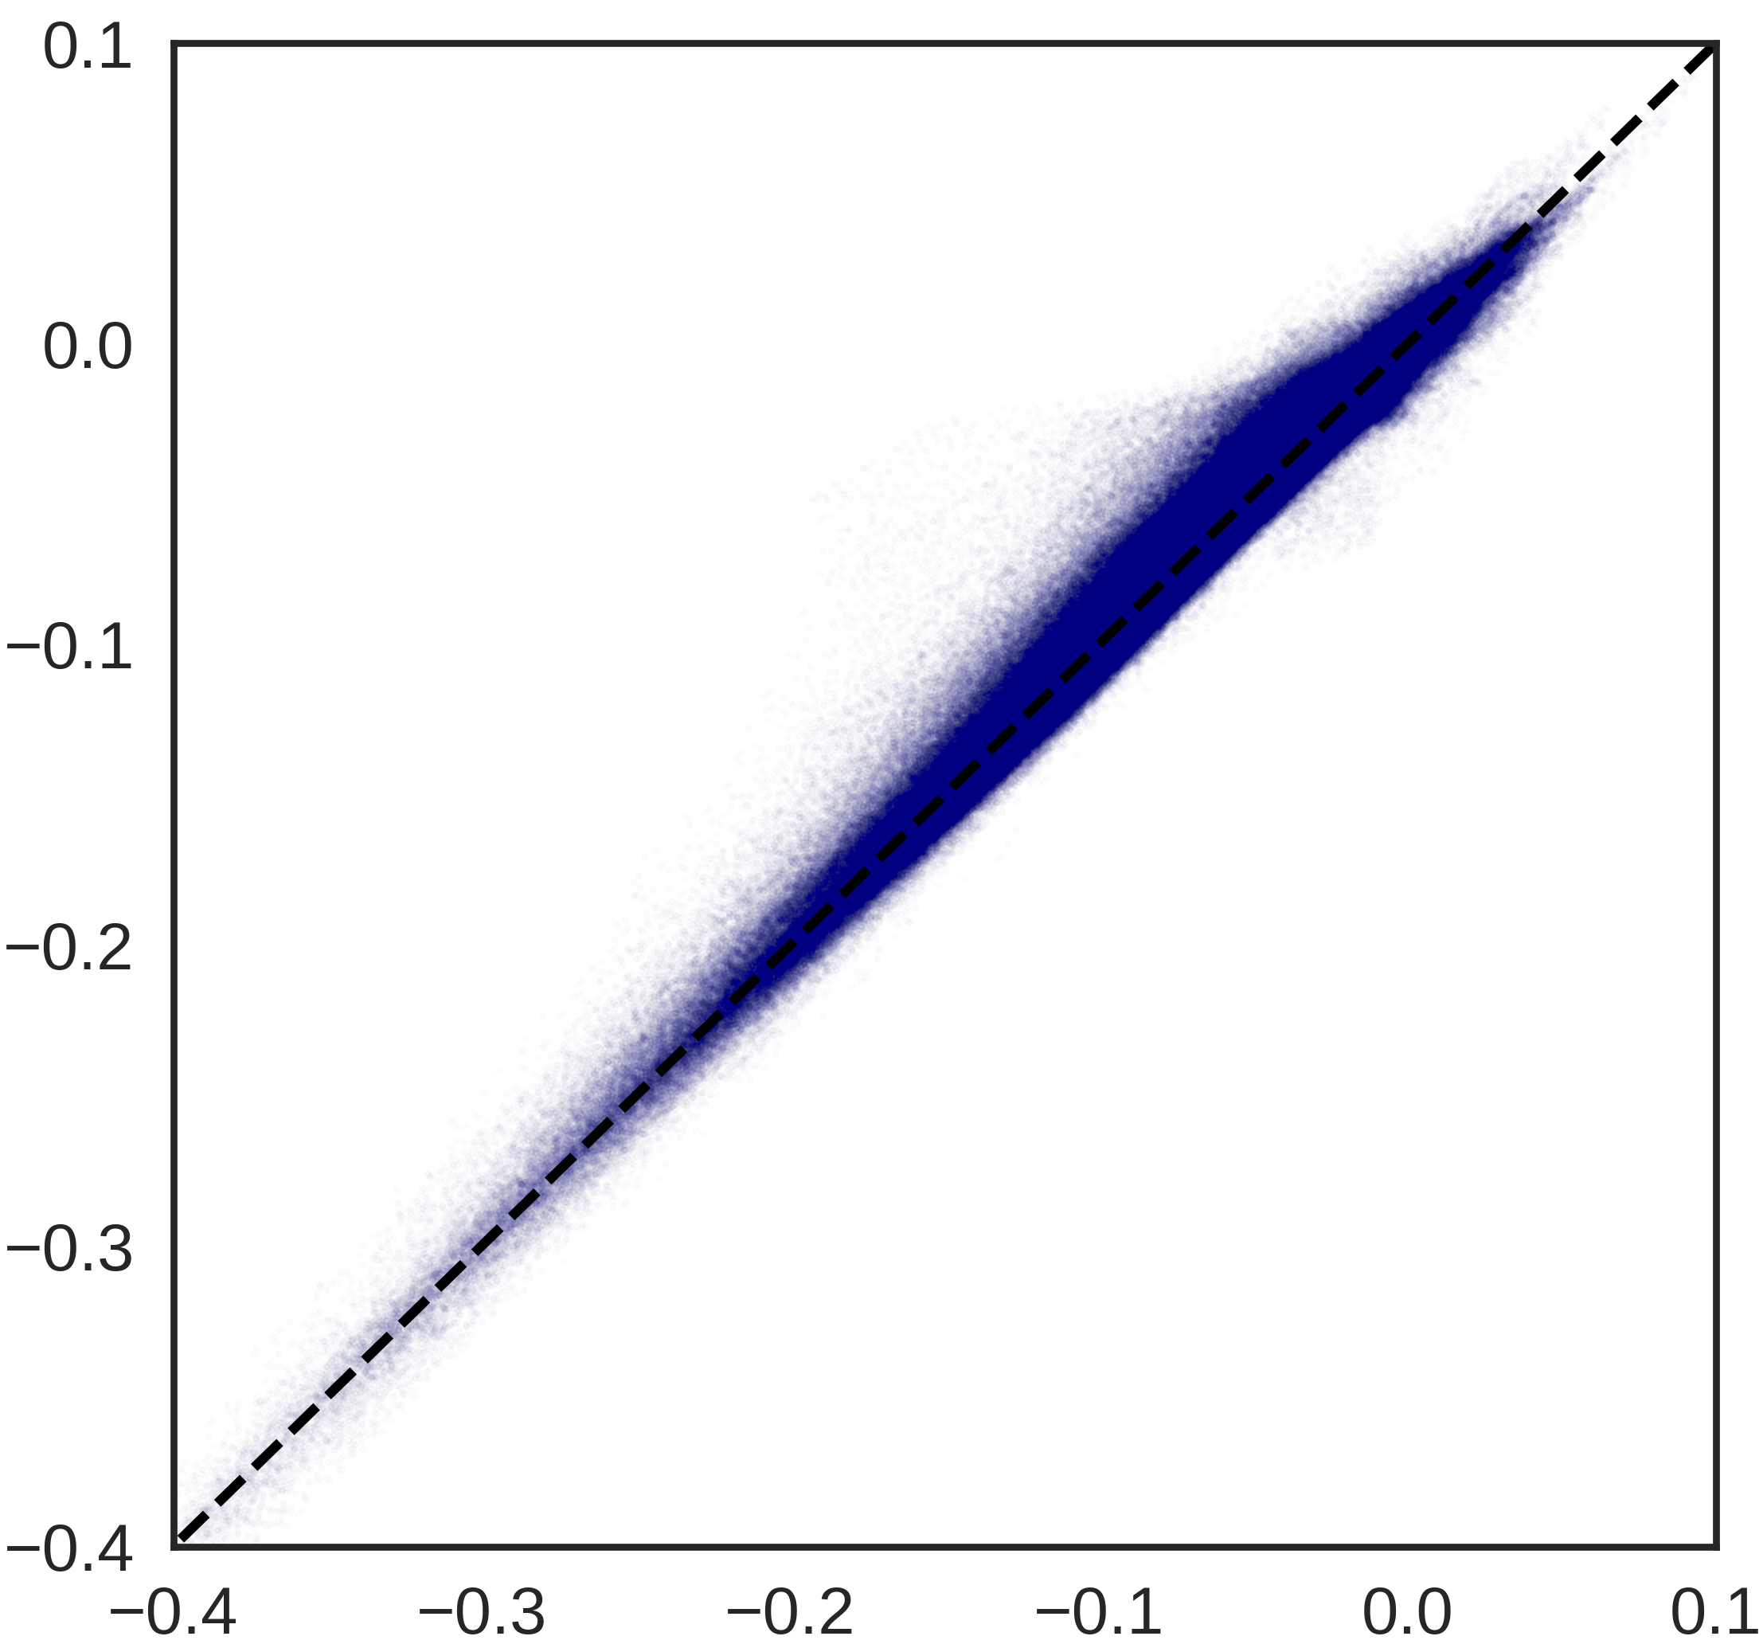
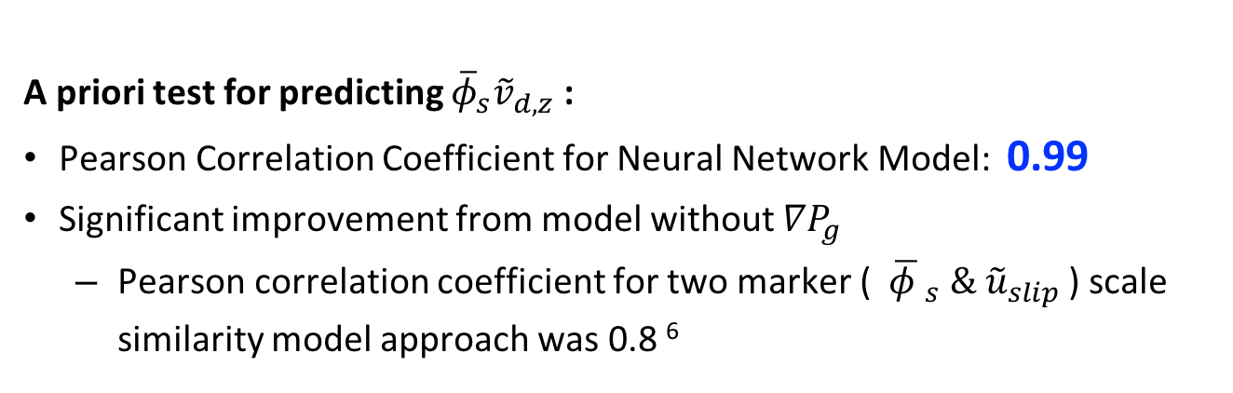


A priori Test: Neural Network Model
A priori test for predicting ${\overline{φ}}_{s}{\tilde{v}}_{d,z}$:
Pearson Correlation Coefficient for Neural Network Model: 0.99
Significant improvement from model without $∇P_{g}$
Pearson correlation coefficient for two marker (${ \overline{φ }}_{s} \& {\tilde{u}}_{slip}$) scale similarity model approach was 0.8 ⁶
$∇P_{g}$ is an important marker for predicting drift velocity
Probability Density
Predicted ${\overline{φ}}_{s}{\tilde{v}}_{d,z}/{(φ}_{max}u_{t})$
Error percent
Real ${\overline{φ}}_{s}{\tilde{v}}_{d,z}/{(φ}_{max}u_{t})$
6. Ozel, A.,Fede, P., Simonin, O., (2013) Int. J Multiph. Flow, 55:43-63 0301 -93222.
Notes:
After building the neural network model, we assessed it with Pearson correlation coefficient, which is computed by dividing the covariance between model predicted and the real value of the target. We found a 0.99 correlation for our neural network model, indicating a very strong correlation. This is a significant improvement from the previous models using only two markers, phi and uSlip, which leads to a correlation of 0.8. Also, the probability density shows that the error is centered at zero, and the parity plot shows that majority of the points are distributed around the parity line. These results validate that we have a very good model.

Slide 15


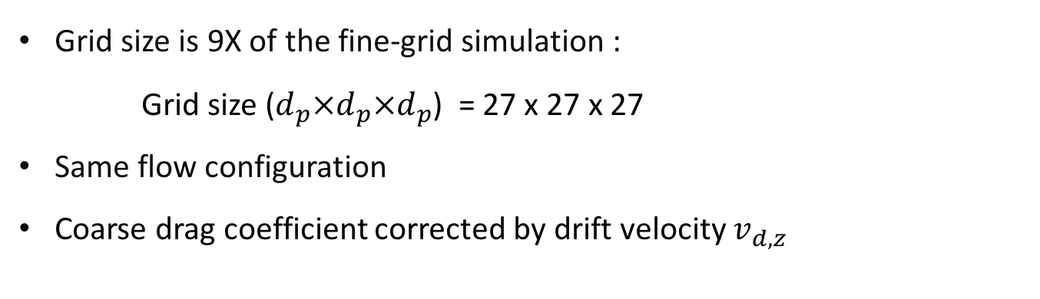
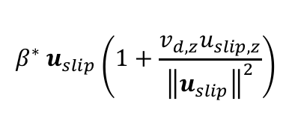

A posteriori Test: Coarse-grid Simulation
Model validated by coarse Euler-Euler simulation
Grid size is 9X of the fine-grid simulation :
Grid size ($d_{p}×d_{p}×d_{p}$) = 27 x 27 x 27
Same flow configuration
Coarse drag coefficient corrected by drift velocity $v_{d,z}$
$$β^{∗} u_{slip}\left(1+\frac{v_{d,z}u_{slip,z}}{{\left\|u_{slip}\right\|}^{2}}\right)$$
$$φ_{s}, u_{slip,z},∇P_{g,z}$$
NN Model
$$φ_{s}v_{d,z}$$
$$F_{d}$$
${\overline{F}}_{d}≈(1+\frac{{\tilde{v}}_{d,z}{\tilde{u}}_{slip,z}}{{\left\|{\tilde{u}}_{slip}\right\|}^{2}}){\tilde{F}}_{d}$ From a priori study: Pearson Correlation Coefficient = 0.99
7. Ozel, A. et al., (2017) Physics of Fluid (2017) 29: 103308.
Notes:
After obtaining the model, we incorporated the neural network model into our fluid solver in OpenFOAM, and conducted posteriori test on a coarser mesh to assess the predictability of our model. As an example, we ran a simulation of the same system with the same configuration as the fine grid simulation, but using a mesh that has a grid size 9 times larger than the fine-grid. We feed in the flow quantities from two fluid model, and used neural network model to predict the drift flux term, and then using this model to compute the corrected drag force. This model is adapted from a recent work in our group. In a priori test, we assessed this model form by applying it to the predicted drift velocity, and a strong correlation was obtained.

Slide 16

A posteriori Test: Coarse-grid Simulation
Simulation Snapshots
$$φ_{s}$$
(a)
Fine-grid (3 d_{p})
(b)
Fine-grid (3 d_{p}) result mapped on coarse grid (27 d_{p})
(c)
Coarse-grid (27 d_{p}) with v_{d} corrected Wen&Yu
(d)
Coarse-grid (27 d_{p}) with Wen&Yu
Notes:
Here are some instantaneous snapshot taken from our simulations. We show the profile in the center plane. (a) shows the find-grid results, (b) is the filtered results using a filter size of 9 times of the grid size, and mapped on the coarse mesh. (d) shows the coarse-grid simulation with uncorrected Wen&Yu drag force. We can see that without taking into account the sub-grid contribution to drag force, we see obvious overprediction of the bed expansion, which is majorly caused by overprediction of the drag force.
,(c) shows the results from coarse-grid simulation using drag force corrected by the neural network model for drift velocity.

Slide 17
A posteriori Test: Coarse-grid Simulation
Axial Direction Solid Volume Fraction Profile
27
3
Wen&Yu overpredicts the bed height for coarse-grid simulation
Drift velocity correction effectively correct drag coefficient - bring the bed expansion closer to fine-grid results
27
Dimension Height
Notes:
Here we take a closer look into the solid volume fraction profile. Compared to the fine grid simulation, the bed height from coarse-grid simulation with drift velocity corrected drag coefficient is similar, whereas the uncorrected case is obviously higher.

Slide 18
A posteriori Test: Coarse-grid Simulation
Particle volume fraction vs. bed elevation
(a) Wen&Yu. (b) Wen&Yu + v_{d}
Notes:
the filtered model is different for different filter sizes
Filtered model predictions are essentially independent of filter size

Slide 19
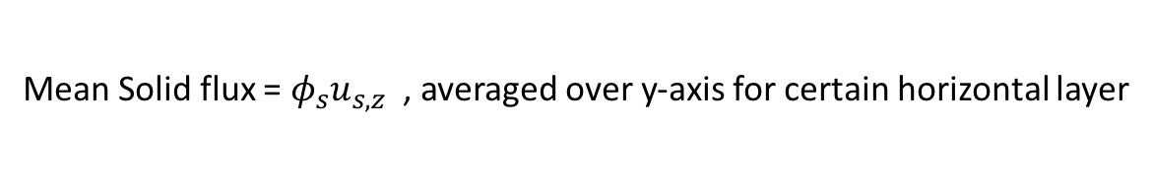
A posteriori Test: Coarse-grid Simulation
Horizontal Direction Solid flux profile
Mean Solid flux = $φ_{s}u_{s,z}$, averaged over y-axis for certain horizontal layer
Z= 40% Bed Height
Z= 80% Bed Height
Dimensionless Solid FLux
Dimensionless Solid FLux
27
27
27
27
Dimensionless Horizontal Position
Dimensionless Horizontal Position
Wen&Yu underpredicts solid flux across the bed and overpredicts the bed expansion
Drift velocity correction produces similar profile as fine-grid simulation
Notes:
To make sure that inside of the bed, the particle physics is still consistent, we computed another metric, horizontal direction solid flux profile. We calculated the mean solid flux as defined here. We picked a specific height in the bed, and average this value along the y axis and plot it along the x-axis. We can see that particles get lifted up towards the center, and roll down near the wall. The coarse-grid case with corrected drag coefficient produces similar result to the fine-grid one, and the uncorrected case tend to underestimate the magnitude of solid flux. This further validates the predictability of our model.

Slide 20
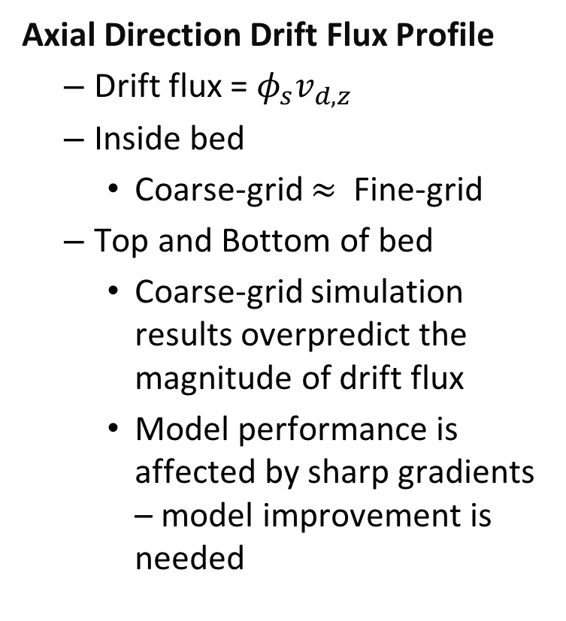
A posteriori Test: Coarse-grid Simulation
Axial Direction Drift Flux Profile
Drift flux = $φ_{s}v_{d,z}$
Inside bed
Coarse-grid $≈$ Fine-grid
Top and Bottom of bed
Coarse-grid simulation results overpredict the magnitude of drift flux
Model performance is affected by sharp gradients – model improvement is needed
Dimensionless Drift FLux
27
Dimensionless Height
Notes:
Lastly, we take a closer look at the drift flux profile. Drift flux is defined by the product of solid volume fraction and drift velocity. We compared this metric between coarse- and fine-grid simulations. We take the average value at each horizontal cross section and plot this average value along the flow direction. We can see that the profile agrees pretty well in side the bed, but at top and bottom of the bed, the neural network model tend to overpredict the magnitude of drift flux, we attribute this discrepancy to the sharp gradients at these two regions. The shargradients added difficulty to the neural network model, implying that there is still space for improvement for our model

Slide 21
Summary
Drift velocity is an essential marker for filtered drag coefficient correction
A transport equation for drift velocity is derived and simplified to identify proper markers for modeling drift velocity
Neural Network model is developed for drift velocity based on filtered fine-grid simulation results
Neural Network model is validated with coarse-grid simulation; Posteriori test results show agreement between coarse and filtered fine-grid simulation results
Future work:
Explicit model form
Other gas-particle systems
Heat and mass transport in gas-particle flow

